Slide 1
Regression Analysis
Regression Analysis in Practice
Nicoleta Serban, Ph.D.
Professor
Stewart School of Industrial and Systems Engineering
Emergency Department Healthcare Costs: Variable Selection

Slide 2

About This Lesson

Slide 3
Lasso Regression
predictors = as.matrix(dataAdult[, -c(1, 2, 3, 4, 5, 10, 13, 18)])
# Set up indicator (dummy) variables for State and Urbanicity
# Leave out one indicator (dummy) variable for each group
#AL= rep(0, length(State))
AR = rep(0, length(State))
LA = rep(0, length(State))
NC = rep(0, length(State))
#AL[as.numeric(factor(State))==1] = 1
AR[as.numeric(factor(State))==2] = 1
LA[as.numeric(factor(State))==3] = 1
NC[as.numeric(factor(State))==4] = 1
#rural = rep(0, length(Urbanicity))
suburban = rep(0, length(Urbanicity))
urban = rep(0, length(Urbanicity))
# rural[as.numeric(factor(Urbanicity))==1] = 1
suburban[as.numeric(factor(Urbanicity))==2] = 1
urban[as.numeric(factor(Urbanicity))==3] = 1
predictors = cbind(predictors, AR, LA, NC, suburban, urban)

Slide 4
Lasso Regression
## 10-fold CV to find the optimal lambda
lassomodel.cv = cv.glmnet(predictors, log(EDCost.pmpm), alpha=1, nfolds=10)
## Fit lasso model with 100 values for lambda
lassomodel = glmnet(predictors, log(EDCost.pmpm), alpha=1, nlambda=100)
## Plot coefficient paths
plot(lassomodel, xvar="lambda", label=TRUE, lwd=2)
abline(v=log(lassomodel.cv$lambda.min), col='black', lty=2, lwd=2)
## Extract coefficients at optimal lambda
coef(lassomodel, lassomodel.cv$lambda.min)

Slide 5
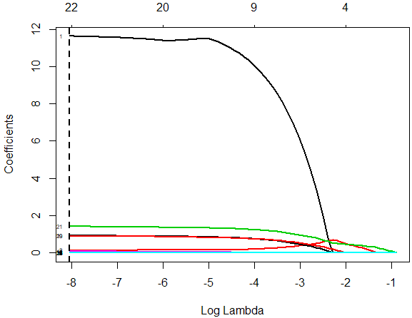
Lasso Regression
(Intercept) | 2.277008e+00
HO | 1.162649e+01
PO | 1.389343e-01
WhitePop | 3.767074e-03
BlackPop | 4.246413e-03
HealthyPop | -1.042170e-03
ChronicPop | -5.704991e-03
Unemployment | 3.421637e-04
Income | -2.307290e-07
Poverty | -2.383079e-04
Education | -1.451700e-03
Accessibility | -1.831102e-03
Availability | 7.664592e-02
RankingsPCP | 7.194696e-04
RankingsFood | 5.782113e-03
RankingsHousing | -4.587208e-03
RankingsExercise | 3.969711e-04
RankingsSocial | .
ProvDensity | 5.923880e-02
AR | 9.183680e-01
LA | 9.027530e-01
NC | 1.410464e+00
suburban | -7.302043e-05
urban | 2.096038e-02
High-coefficient path corresponds to HO variable
RankingsSocial dummy variable is not selected
Other large-coefficient paths correspond to State dummy variables (AR, LA, NC)

Slide 6
Elastic Net Regression
## 10-fold CV to find the optimal lambda
enetmodel.cv = cv.glmnet(predictors, log(EDCost.pmpm), alpha=0.5, nfolds=10)
## Fit lasso model with 100 values for lambda
enetmodel = glmnet(predictors, log(EDCost.pmpm), alpha=0.5, nlambda=100)
## Plot coefficient paths
plot(enetmodel, xvar="lambda", label=TRUE, lwd=2)
abline(v=log(enetmodel.cv$lambda.min), col='black', lty=2, lwd=2)
## Extract coefficients at optimal lambda
coef(enetmodel, s=enetmodel.cv$lambda.min)

Slide 7
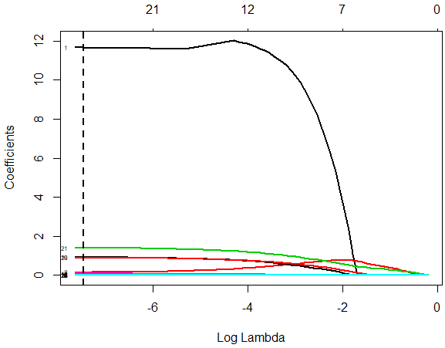
Elastic Net Regression
(Intercept) | 2.288092e+00
HO | 1.165709e+01
PO | 1.478576e-01
WhitePop | 3.688873e-03
BlackPop | 4.184739e-03
HealthyPop | -1.170339e-03
ChronicPop | -5.767968e-03
Unemployment | 3.568585e-04
Income | -2.361412e-07
Poverty | -2.646852e-04
Education | -1.451879e-03
Accessibility | -1.859399e-03
Availability | 7.703073e-02
RankingsPCP | 7.168545e-04
RankingsFood | 5.944554e-03
RankingsHousing | -4.569033e-03
RankingsExercise | 4.221634e-04
RankingsSocial | .
ProvDensity | 5.941349e-02
AR | 9.140417e-01
LA | 8.996673e-01
NC | 1.404530e+00
suburban | -3.213212e-04
urban | 2.105330e-02
High-coefficient path corresponds to HO variable
RankingsSocial dummy variable is not selected
Other large-coefficient paths correspond to State dummy variables (AR, LA, NC)

Slide 8
Stepwise Regression
full = lm(log(EDCost.pmpm) ~ HealthyPop + ChronicPop + State + Urbanicity + HO + PO +
BlackPop + WhitePop + Unemployment + Income + Poverty+ Education +
Accessibility + Availability + ProvDensity +
RankingsPCP + RankingsFood + RankingsExercise + RankingsSocial, data=dataAdult)
minimum = lm(log(EDCost.pmpm) ~ HealthyPop + ChronicPop, data=dataAdult)
# Forward Stepwise Regression
forward.model = step(minimum, scope=list(lower=minimum, upper=full), direction="forward")
summary(forward.model)
# Backward Stepwise Regression
backward.model = step(full, scope=list(lower=minimum, upper=full), direction = "backward")
summary(backward.model)
# Forward-Backward Stepwise Regression
both.min.model = step(minimum, scope=list(lower=minimum, upper=full), direction = "both")
summary(both.min.model)

Slide 9
Stepwise Regression
Observations
Variables not selected:
  Unemployment, Income, Poverty, RankingExercise, RankingsSocial
Urbanicity was not statistically significant
Variables selected first by forward stepwise regression, in order
  State dummy variables (StateAR, StateLA, StateNC)
  Number of inpatient claims per-member-per-month

Slide 10
Stepwise Regression Model
Estimate Std. Error t value Pr(>|t|)
(Intercept) 2.0271089 0.0995378 20.365 < 2e-16 ***
HealthyPop -0.0005092 0.0007837 -0.650 0.515917
ChronicPop -0.0051250 0.0020252 -2.531 0.011418 *
StateAR 0.9324593 0.0155667 59.901 < 2e-16 ***
StateLA 0.9003846 0.0118631 75.898 < 2e-16 ***
StateNC 1.4268425 0.0157605 90.533 < 2e-16 ***
HO 12.0476486 0.7237072 16.647 < 2e-16 ***
Education -0.0016689 0.0002312 -7.218 6.08e-13 ***
ProvDensity 0.0605923 0.0156154 3.880 0.000106 ***
RankingsPCP 0.0007885 0.0001577 5.000 5.94e-07 ***
Availability 0.0756249 0.0191618 3.947 8.03e-05 ***
Accessibility -0.0019930 0.0007001 -2.847 0.004433 **
PO 0.1232428 0.0406869 3.029 0.002466 **
UrbanicitySuburban -0.0017746 0.0136754 -0.130 0.896758
UrbanicityUrban 0.0226383 0.0124409 1.820 0.068870 .
BlackPop 0.0050790 0.0005596 9.076 < 2e-16 ***
WhitePop 0.0046371 0.0005522 8.398 < 2e-16 ***
RankingsFood 0.0158764 0.0040770 3.894 9.98e-05 ***
---
Signif. codes: 0 ‘***’ 0.001 ‘**’ 0.01 ‘*’ 0.05 ‘.’ 0.1 ‘ ’ 1
Residual standard error: 0.2322 on 5001 degrees of freedom
Multiple R-squared: 0.8483, Adjusted R-squared: 0.8478
F-statistic: 1645 on 17 and 5001 DF, p-value: < 2.2e-16
Both models explain the same amount of variance (about 84%). Prefer the smaller model.
Urbanicity is not statistically significant at α = 0.05.
Access to primary care (Accessibility and Availability) is statistically significantly associated to ED cost.

Slide 11
Stepwise Regression Vs Full Models
## Compare full model to selected model
reg.step = lm(log(EDCost.pmpm) ~ HealthyPop + ChronicPop + State + Urbanicity + HO
+ PO + BlackPop + WhitePop + Education + Accessibility + Availability
+ ProvDensity + RankingsPCP + RankingsFood, ,data=dataAdult)
anova(reg.step, full)
Res.Df RSS Df Sum of Sq F Pr(>F)
1 5001 269.56
2 4996 269.46 5 0.10406 0.3859 0.8588
P-value large
  Do not reject the null hypothesis (reduced model)
The reduced model is plausibly as good in terms of explanatory power as the full model

Slide 12
Residual Analysis: Outliers & Normality
red.resid = rstandard(reg.step)
red.cook = cooks.distance(reg.step)
## Check outliers
influencePlot(reg.step)
plot(red.cook,type="h",lwd=3,col="red", ylab = "Cook's Distance")
## Check normality
qqPlot(red.resid, ylab="Residuals", main = "")
qqline(red.resid, col="red", lwd=2)
hist(red.resid, xlab="Residuals", main = "", nclass=30, col="orange")

Slide 13
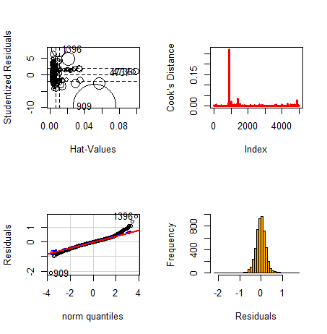
Residual Analysis: Outliers & Normality
Outliers
Observation 909 stands out
Normality
Symmetric but with heavy tails

Slide 14
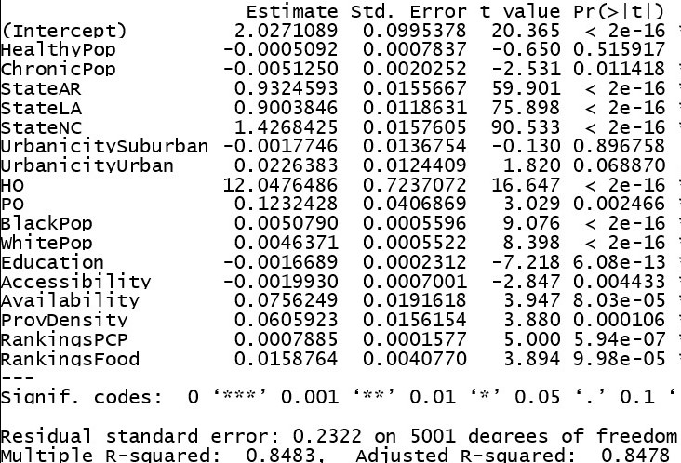
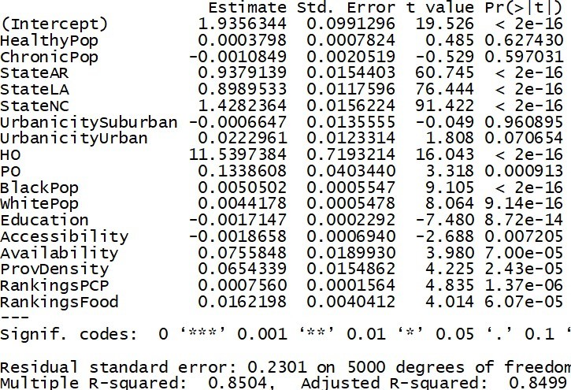
Removing Outlier?
Regression Output: With Outlier
Regression Output: Without Outlier

Slide 15
Model Interpretation: State Differences
Comparing 2011 ED Costs by Location (AL, AR, LA, and NC)
Controlling for utilization, access, and socioeconomics
In AR versus AL
  ED cost PMPM is exp(0.938) = $2.55 higher
  ED cost per member per year is $30.65 higher
In LA versus AL
  ED cost PMPM is exp(0.899) = $2.46 higher
  ED cost per member per year is $29.49 higher
In NC versus AL
  ED cost PMPM is exp(1.428) = $4.17 higher
  ED cost per member per year is $50.04 higher
Overall Interpretation: Controlling for many potential factors contributing to ED costs, North Carolina pays significantly more while Alabama pays significantly less per member on emergency care than do Louisiana and Arkansas.

Slide 16
Model Interpretation: Utilization
Healthcare Utilization
PO
  Proxy of regular care utilization
  Number of claims reimbursed for care in a physician's office
HO
  Proxy of inpatient care utilization
  Number of claims reimbursed for hospital care
Interpretation
An increase of 1 claim PMPM for regular care results in a 0.133 increase in log of ED cost PMPM, given all other predictors fixed
An increase of 1 claim PMPM for inpatient care results in a 11.54 increase in log of ED cost PMPM, given all other predictors fixed

Slide 17
Model Interpretation: Access to Care
Access to primary care
Availability
  Proxy of wait times for appointment
  Takes values between 0 (low wait time) and 1 (high wait time)
Accessibility
  Travel distance to primary care providers, measured in miles
Interpretation
An increase of 0.01 or 1% in lack of availability of primary care providers results in 0.000755 unit increase in log(ED cost PMPM) given all other predictors fixed
A reduction of 1 mile in travel distance to primary care providers results in 0.002 unit increase in log(ED cost PMPM) given all other predictors fixed
The correlation between the two measures is 0.696. If Availability is discarded from the model, Accessibility is not statistically significant.

Slide 18

Summary

